Slide 1

Software Architecture And Design
Sec.2
Eng. Al-hassan Mohamed
Eng. Mariam Malak

Slide 2

AGENDA
Agenda
Quize
Templates inheritance :include vs extend

Slide 3

extends

Slide 4
extends
Allows a template to inherit from a base (parent) template.
Define a common layout (skeleton) and let child templates override specific blocks.
We inherit from the base layout not insert it to our structure which means we have same layout or base project layout and want to change page content.
Constant structure but different content across pages.
Child templates can override blocks defined in the parent
More efficient for large projects since structure is centralized.
[How does this happen??]

Slide 5
extends
First, we will create the base file [common layout] that we’ll inherit it.
Where we want the content to chang, we add JINJA structure to it called block
Name of the block

Slide 6
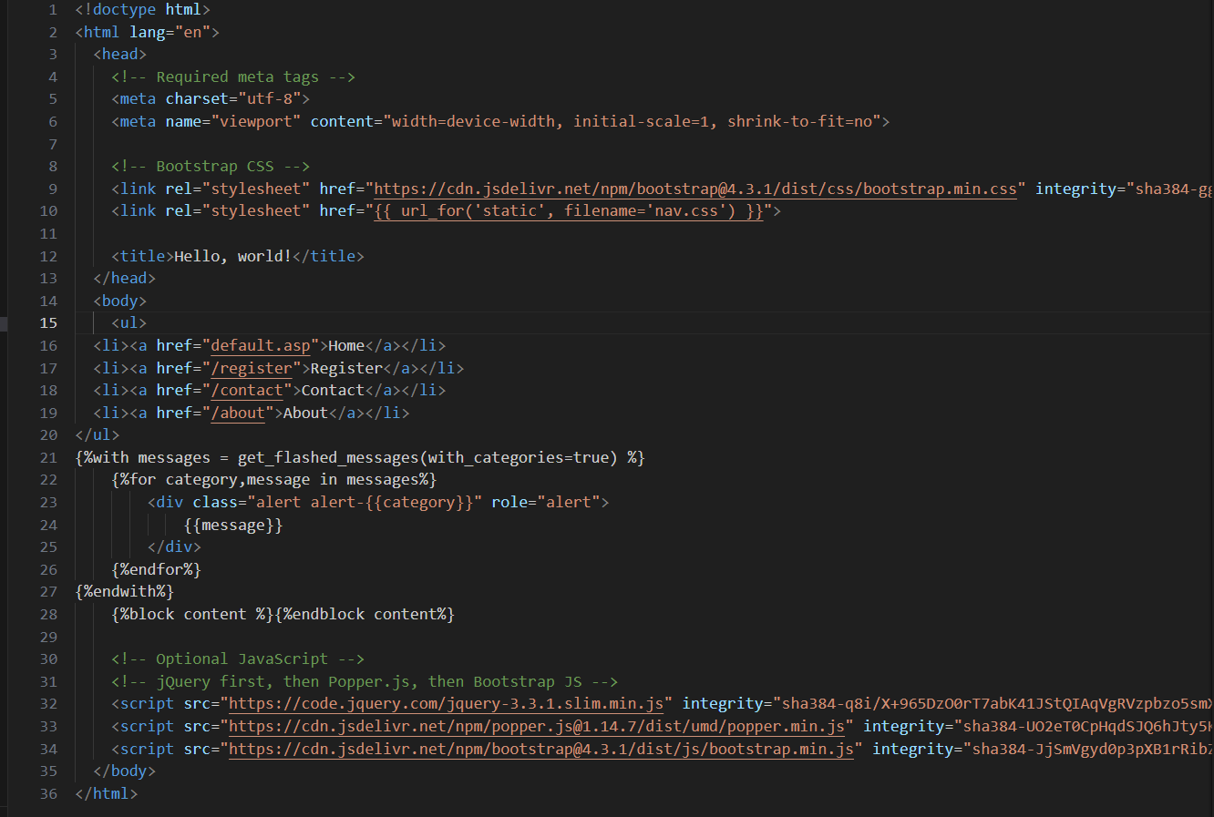
Complete base file structure
Where we’ll add different views
Notes:
<!doctype html>
<html lang="en">
<head>
<!-- Required meta tags -->
<meta charset="utf-8">
<meta name="viewport" content="width=device-width, initial-scale=1, shrink-to-fit=no">
<!-- Bootstrap CSS -->
<link rel="stylesheet" href="https://cdn.jsdelivr.net/npm/bootstrap@4.3.1/dist/css/bootstrap.min.css" integrity="sha384-ggOyR0iXCbMQv3Xipma34MD+dH/1fQ784/j6cY/iJTQUOhcWr7x9JvoRxT2MZw1T" crossorigin="anonymous">
<link rel="stylesheet" href="{{ url_for('static', filename='nav.css') }}">
<title>Hello, world!</title>
</head>
<body>
<ul>
<li><a href="default.asp">Home</a></li>
<li><a href="/register">Register</a></li>
<li><a href="/contact">Contact</a></li>
<li><a href="/about">About</a></li>
</ul>
{%with messages = get_flashed_messages(with_categories=true) %}
{%for category,message in messages%}
<div class="alert alert-{{category}}" role="alert">
{{message}}
</div>
{%endfor%}
{%endwith%}
{%block content %}{%endblock content%}
<!-- Optional JavaScript -->
<!-- jQuery first, then Popper.js, then Bootstrap JS -->
<script src="https://code.jquery.com/jquery-3.3.1.slim.min.js" integrity="sha384-q8i/X+965DzO0rT7abK41JStQIAqVgRVzpbzo5smXKp4YfRvH+8abtTE1Pi6jizo" crossorigin="anonymous"></script>
<script src="https://cdn.jsdelivr.net/npm/popper.js@1.14.7/dist/umd/popper.min.js" integrity="sha384-UO2eT0CpHqdSJQ6hJty5KVphtPhzWj9WO1clHTMGa3JDZwrnQq4sF86dIHNDz0W1" crossorigin="anonymous"></script>
<script src="https://cdn.jsdelivr.net/npm/bootstrap@4.3.1/dist/js/bootstrap.min.js" integrity="sha384-JjSmVgyd0p3pXB1rRibZUAYoIIy6OrQ6VrjIEaFf/nJGzIxFDsf4x0xIM+B07jRM" crossorigin="anonymous"></script>
</body>
</html>

Slide 7
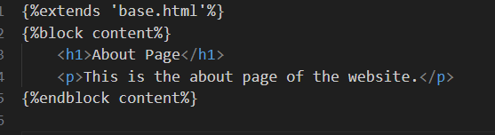
extends
Second, we’ll create the file that will extend the base file
Let’s update our jop-list page
Name of the base file
Name of the block we’ll write in “same name as in base file”
Notes:
{%extends 'base.html'%}
{%block content%}
<h1>About Page</h1>
<p>This is the about page of the website.</p>
{%endblock content%}

Slide 8
include

Slide 9
Include
Inserts another template directly into the current one.
Reuse small, repeatable fragments (headers, footers, navbars).
Renders the included file as-is, no block overriding.
Like copy-pasting a snippet into your file

Slide 10

THANK YOU

